Slide 2
learn MapReduce types
learn input formats and output formats in hadoop and mapreduce

Slide 3
Map Reduce Types
The map and reduce functions in Hadoop MapReduce have the following general form:
map: (K1, V1) → list(K2, V2)
reduce: (K2, list(V2)) → list(K3, V3)

Slide 4
Map Reduce Types
public void map(LongWritable key, Text value, Context context)
{ .....
.....
context.write(new Text(year), new IntWritable(airTemperature));
}
public void reduce(Text key, Iterable values, Context context)
{
..................
context.write(key, new IntWritable(maxValue));
}
public void combiner(Text key, Iterable values, Context context)
{
..................
context.write(key, new IntWritable(maxValue));
}

Slide 5
Map Reduce Types
If a combine function is used, then it is the same form as the reduce function (and is an implementation of Reducer), except its output types are the intermediate key and value types (K2 and V2), so they can feed the reduce function:
map: (K1, V1) → list(K2, V2)
combine: (K2, list(V2)) → list(K2, V2)
reduce: (K2, list(V2)) → list(K3, V3)
Often the combine and reduce functions are the same, in which case, K3 is the same as K2, and V3 is the same as V2.

Slide 6
Map Reduce Types
How input types are set?

Slide 7
Map Reduce Types
job.setOutputKeyClass(Text.class);
job.setOutputValueClass(IntWritable.class);

Slide 8
Map Reduce Types
So if K2 and K3 are the same, you don’t need to call setMapOutputKeyClass(), since it falls back to the type set by calling setOutputKeyClass().
Similarly, if V2 and V3 are the same, you only need to use setOutputValueClass().

Slide 9
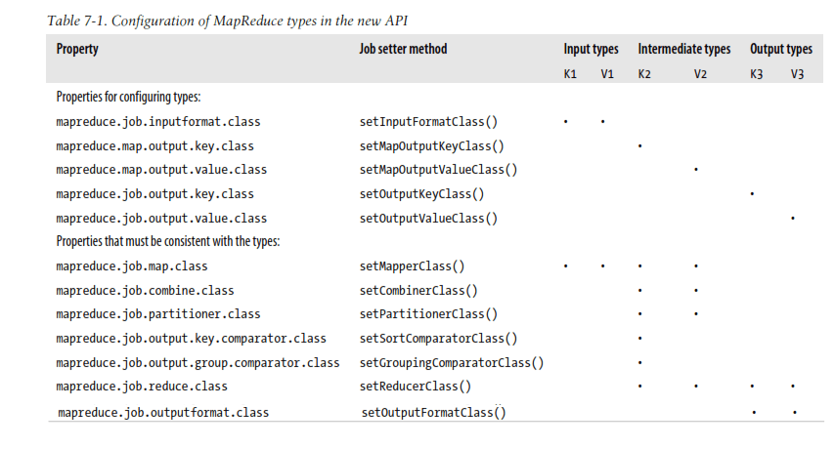
Configuration of MapReduce in the new API

Slide 10
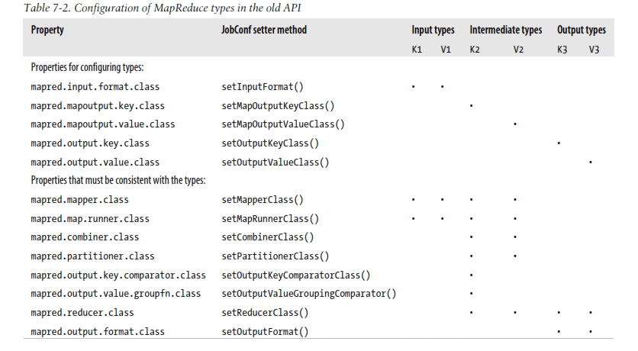
Configuration of MapReduce types in the old API

Slide 11
Input Formats
Hadoop can process many different types of data formats, from flat text files to databases

Slide 12
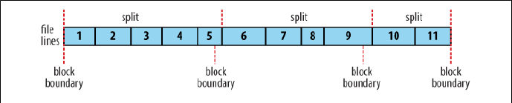
Input Formats
The Relationship Between Input Splits and HDFS Block

Slide 13
Text Input
So a file containing the following text:
On the top of the Crumpetty Tree The Quangle Wangle sat, But his face you could not see, On account of his Beaver Hat.

Slide 14
Text Input
So a file containing the following text: | The records are interpreted as the following key-value pairs:
On the top of the Crumpetty Tree The Quangle Wangle sat, But his face you could not see, On account of his Beaver Hat. | (0, On the top of the Crumpetty Tree) (33, The Quangle Wangle sat,) (57, But his face you could not see,) (89, On account of his Beaver Hat.)

Slide 15
Text Input
KeyValueTextInputFormat

Slide 16
Text Input
mapreduce.input.keyvaluelinerecodreader.key.value.separator property
Or
key.value.separator.in.input.line
in the old API

Slide 17
Text Input
Consider the following input file, where → represents a (horizontal) tab character:
line1→On the top of the Crumpetty Tree
line2→The Quangle Wangle sat,
line3→But his face you could not see,
line4→On account of his Beaver Hat.

Slide 18
Text Input
NLineInputFormat

Slide 19
Text Input
On the top of the Crumpetty Tree
The Quangle Wangle sat,
But his face you could not see,
On account of his Beaver Hat.

Slide 20
Text Input
If, for example, N is two, then each split contains two lines.
One mapper will receive the first two key-value pairs:
(0, On the top of the Crumpetty Tree)
(33, The Quangle Wangle sat,)

Slide 21
Text Input
And another mapper will receive the second two key-value pairs:
(57, But his face you could not see,)
(89, On account of his Beaver Hat.)

Slide 22
Text Input
XML
set your input format to StreamInputFormat and
set the stream.recordreader.class property to org.apache.hadoop.streaming.StreamXmlRecordReader
to use xml as an input format.

Slide 23
Text Input
Binary Input :
SequenceFileInputFormat

Slide 24
Text Input
Binary Input :
SequenceFileInputFormat
SequenceFileAsTextInputFormat

Slide 25
Text Input
Binary Input :
SequenceFileInputFormat
SequenceFileAsTextInputFormat
SequenceFileAsBinaryInputFormat

Slide 26
Text Input
SequenceFileInputFormat
Hadoop’s sequence file format stores sequences of binary key-value pairs. Sequence files are well suited as a format for MapReduce data since they are splittable they support compression as a part of the format.

Slide 27
Text Input
SequenceFileAsTextInputFormat
SequenceFileAsTextInputFormat is a variant of SequenceFileInputFormat that converts the sequence file’s keys and values to Text objects.

Slide 28
Text Input
SequenceFileAsBinaryInputFormat
SequenceFileAsBinaryInputFormat is a variant of SequenceFileInputFormat that retrieves the sequence file’s keys and values as opaque binary objects.

Slide 29
Text Input
Multiple Inputs
The input to a MapReduce job may consist of multiple input files. This case is handled elegantly by using the MultipleInputs class.

Slide 30
Text Input
MultipleInputs.addInputPath(job, ncdcInputPath, TextInputFormat.class, MaxTemperatureMapper.class);
MultipleInputs.addInputPath(job, metOfficeInputPath, TextInputFormat.class, MetOfficeMaxTemperatureMapper.class);

Slide 31
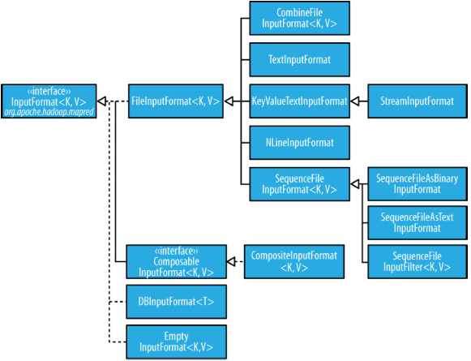
Database Input
Input format class hierarchy

Slide 32
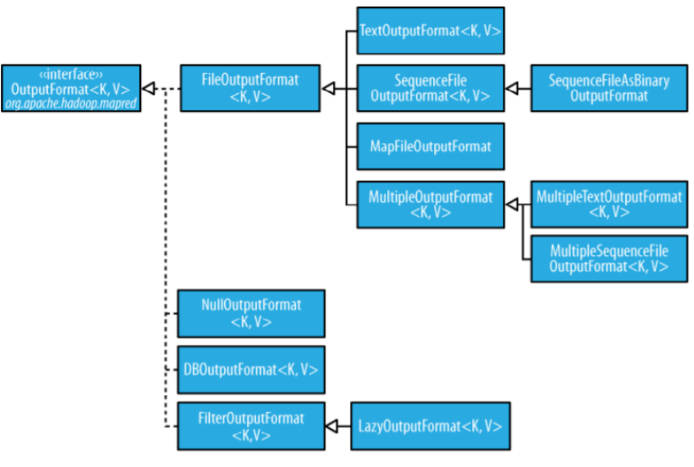
Database Input
Output format class hierarchy

Slide 33
Text Output
The default output format, TextOutputFormat, writes records as lines of text.
Its keys and values may be of any type, since TextOutputFormat turns them to strings by calling toString() on them.
Each key-value pair is separated by a tab character. The counterpart to TextOutput Format for reading in this case is KeyValueTextInputFormat.

Slide 34
Binary Output
SequenceFileOutputFormat

Slide 35
Binary Output
SequenceFileOutputFormat
SequenceFileAsBinaryOutputFormat

Slide 36
Binary Output
SequenceFileOutputFormat
SequenceFileAsBinaryOutputFormat
MapFileOutputFormat

Slide 37
Hadoop InputFormat
Hadoop InputFormat
Describes the input-specification for execution.
Describes how to split up and read input files.
InputFormat is the first step.
Responsible for creating the input splits and dividing them into records.
Input files reside in HDFS.

Slide 38
Hadoop InputFormat
Hence, In MapReduce, InputFormat class is one of the fundamental classes which provides below functionality:
It selects the files or other objects for input.
It also defines the Data splits.
It defines the RecordReader.

Slide 39
Hadoop InputFormat
How we get the data from Mapper?
public abstract class InputFormat<K, V>
{
public abstract List<InputSplit> getSplits(JobContext context)
throws IOException, InterruptedException;
public abstract RecordReader<K, V>
createRecordReader(InputSplit split,
TaskAttemptContext context) throws IOException,
InterruptedException;
}

Slide 40
Hadoop InputFormat
Types of InputFormat in MapReduce
FileInputFormat
TextInputFormat
Key
Value
KeyValueTextInputFormat
SequenceFileInputFormat
SequenceFileAsTextInputFormat
SequenceFileAsBinaryInputFormat
NlineInputFormat
DBInputFormat

Slide 41
Hadoop InputFormat
Types of InputFormat in MapReduce
  FileInputFormat

Slide 42
Hadoop InputFormat
Types of InputFormat in MapReduce
  FileInputFormat
  TextInputFormat

Slide 43
Hadoop InputFormat
Types of InputFormat in MapReduce
  FileInputFormat
  TextInputFormat
  KeyValueTextInputFormat

Slide 44
Hadoop InputFormat
Types of InputFormat in MapReduce
  FileInputFormat
  TextInputFormat
  KeyValueTextInputFormat
  SequenceFileInputFormat

Slide 45
Hadoop InputFormat
Types of InputFormat in MapReduce
  FileInputFormat
  TextInputFormat
  KeyValueTextInputFormat
  SequenceFileInputFormat
  NlineInputFormat

Slide 46
Hadoop InputFormat
Types of InputFormat in MapReduce
  FileInputFormat
  TextInputFormat
  KeyValueTextInputFormat
  SequenceFileInputFormat
  NlineInputFormat
  DBInputFormat

Slide 47
Hadoop InputFormat
Types of InputFormat in MapReduce
  FileInputFormat
  TextInputFormat
  KeyValueTextInputFormat
  SequenceFileInputFormat
  NlineInputFormat
  DBInputFormat
  Sequence FileAs BinaryInputFormat

